Slide 1
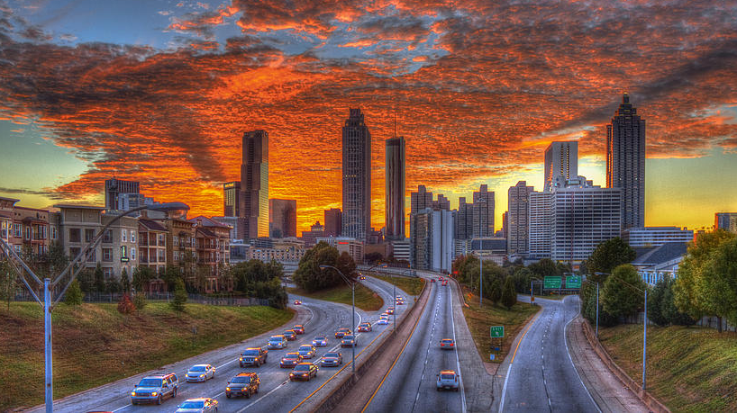
Smart City Funding and Financing Georgia Smart Community Workshop

Slide 2
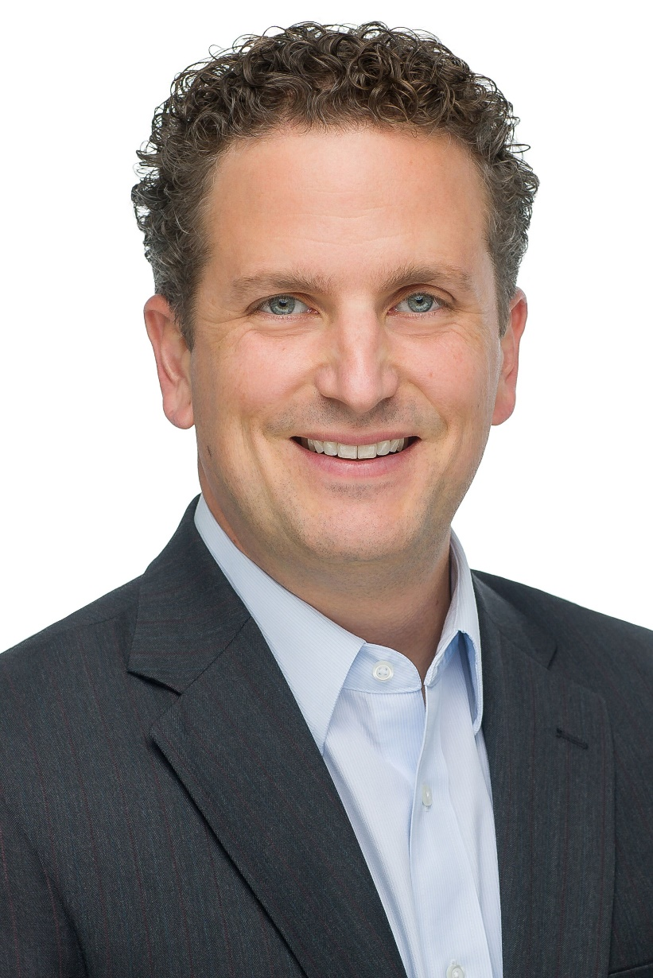
Lee Davenport
Director of Community Development US Ignite
lee.davenport@us-ignite.org
Notes:
US Ignite is accelerating the smart city movement – and creating value for an entire ecosystem – by guiding communities into the connected future, creating a path for private sector growth, and advancing technology research that’s at the heart of smart city development.
As US Ignite’s Director of Community Development, I support our partnership efforts across more than 30 rural and urban communities with a wide array of shared objectives, governance structures, and high-value partnerships. This initiative engages many leading infrastructure, academic, nonprofit, and government entities. Working together, we to encourage broad utilization of advanced applications and next-generation networks that improve quality of life, create jobs, and drive economic activity. Prior to this role, I helped startup an FCC-supported nonprofit that connected millions of families with low-cost internet and served as Vice President of Programs for a global, digital inclusion nonprofit organization.

Slide 3
Origins of Smart City Opportunities
Efficiency
Enrichment
Quality of life improvements (public health, STEM education, carbon footprint)
Cost savings in municipal service (e.g. waste management, energy consumption)
Growth
Economic opportunity through new startups, jobs, and investment in innovation zones
Safety
Air quality, pedestrian safety, fire, and police location services
Access
Broadband solutions designed to bridge digital divide

Slide 4
Smart City Funding and Financing
Funding → $0 cost or $0 private sector profit
Donated hardware/software (Safety Zones)
Public Private Partnership (Rail/Auto Traffic Efficiency)
Financing → Some or no cost, generates profit
Transportation and mobility (EV Charging)
Electricity generation and delivery (Smart Grid)
Energy Efficiency (Smart LED lighting)
Digital Inclusion (Vouchers)

Slide 5
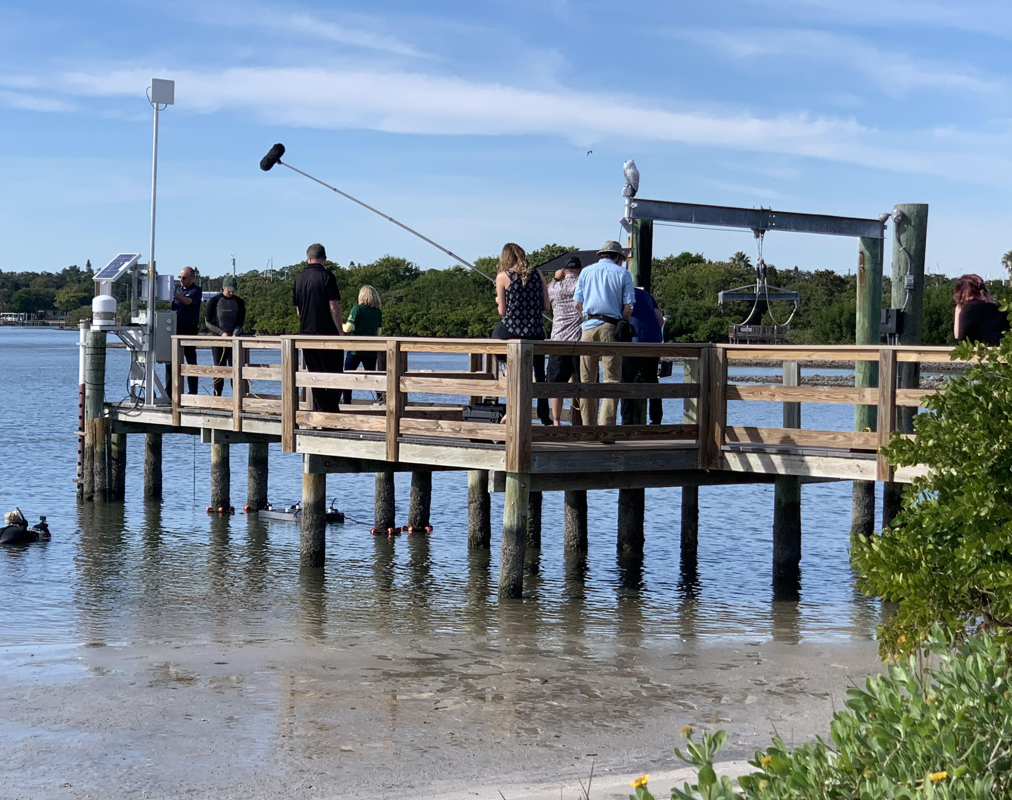
St. Petersburg Funding Case Study
Innovation District facilitated sessions w/ academic, private, civic, & industry leaders
Key Projects: smart streetlights & immersive education
Deployed reef w/ marine sensors and a STEM curriculum
St Pete received individual project-specific technical support
IDC Smart City 2020
Notes:
Mission: “Leveraging advanced wireless and wired networks, the St Pete Innovation District will continue to drive jobs and startups in targeted industries (i.e., data analytics, healthcare, marine science, and fintech) and expand the innovation activities.”
In St Pete, this work proves that it's as much about the quality of the partnership, not just the proposals.

Slide 6
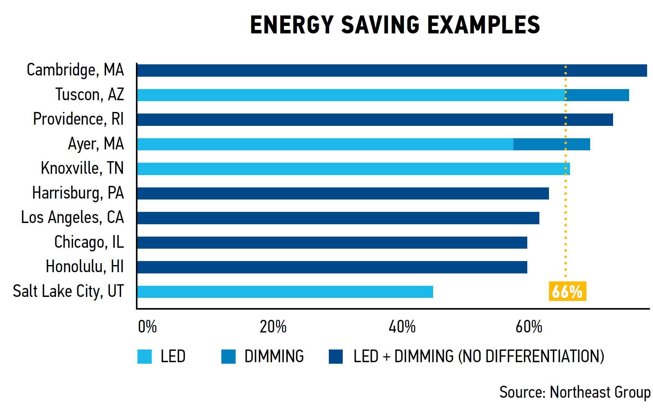
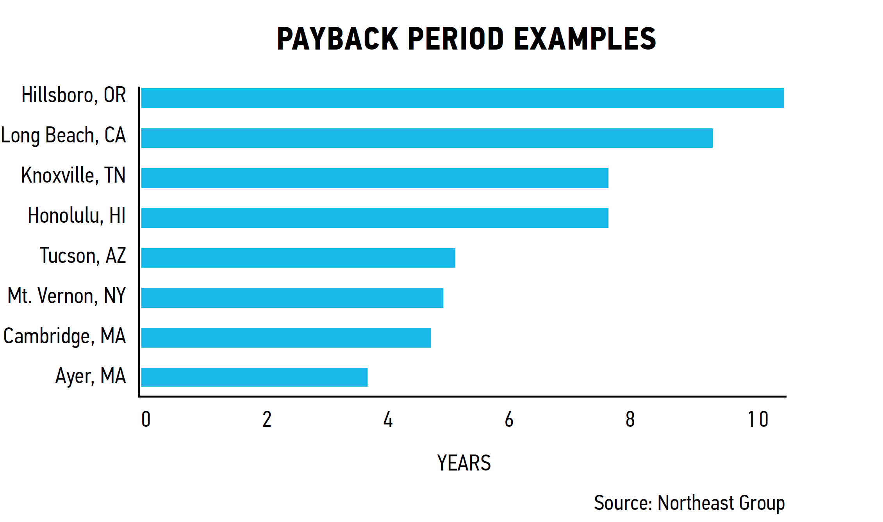
Financing with LED replacements
Decreased energy costs with LEDs by up to 75%
Net savings of $400 per streetlight at 10 years
Streamlined maintenance: less failure, fewer truck rolls
Decreased carbon emissions
Notes:
Some costs inflated by some cities buying back their streetlights, skewing their costs.
Cost advantage is combined Streetlight and smart device saves truck rolls and layering makes sense.

Slide 7
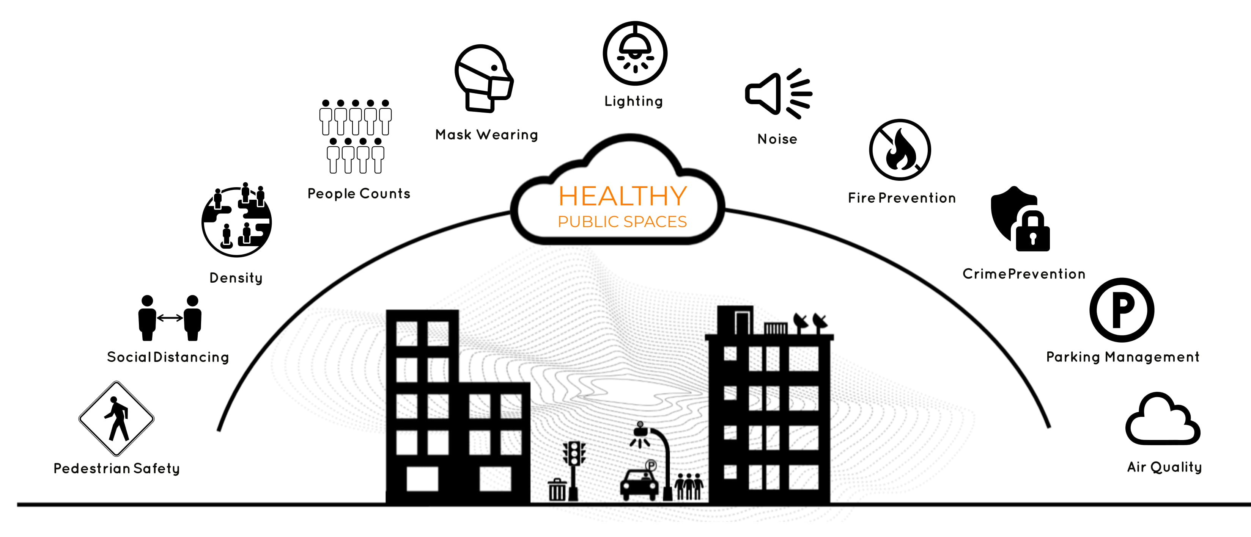
2020 compels a range of innovation

Slide 8
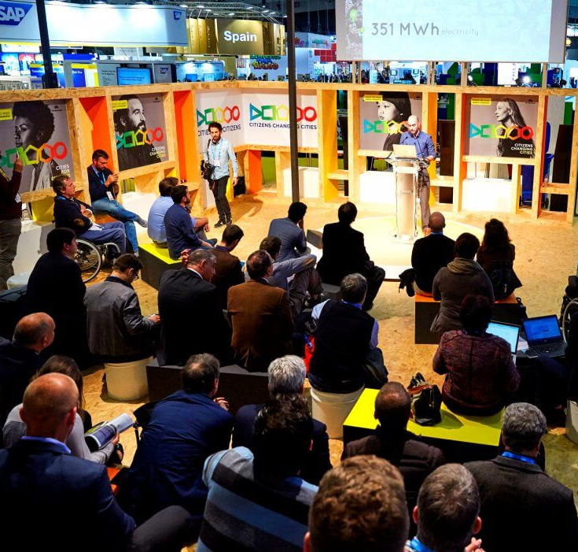
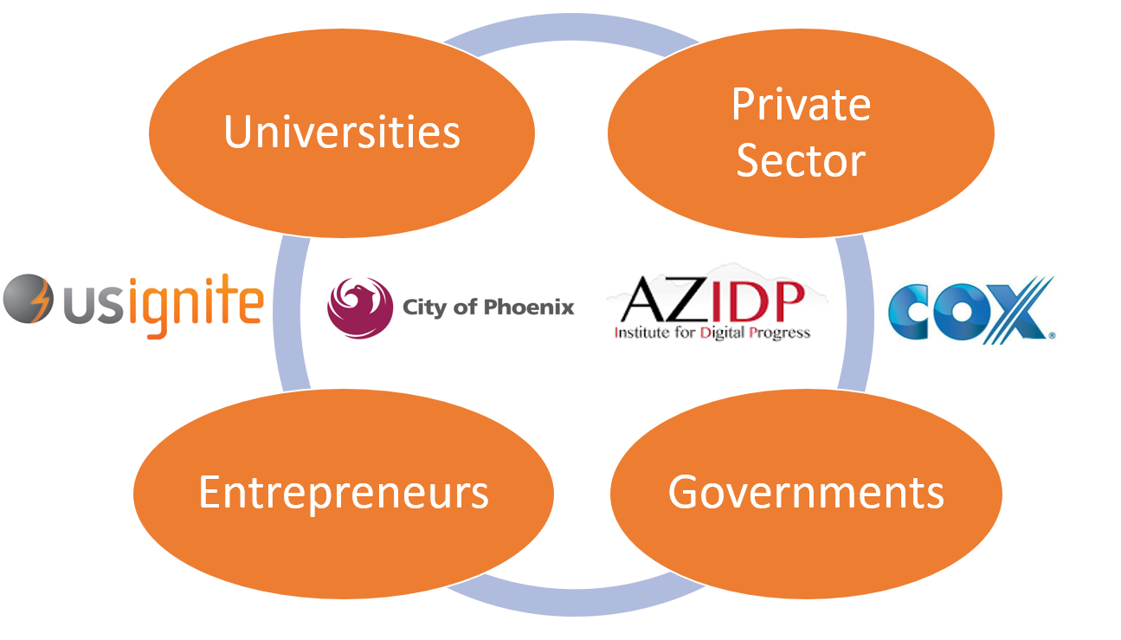
Phoenix Case Study
Selected waste management and transportation as key projects
Expanded smart region to include 15 cities and state-level projects
Formed Greater Phoenix Smart Region Consortium
Notes:
Community-Wide Engagement: US Ignite partnered with local leaders to establish a steering group that included local government CIOs, mayors, university researchers, and leading technology companies. This group created organizational alignment and drove commitment to smart city initiatives including the Smart City Hack, smart Workforce Development, and Urban iLabs.
Community Network Infrastructure Enhancement: Partnership with Cable Provider ensured deployment of gigabit infrastructure at local innovation hubs and local innovation community centers.
Developed a smart community plan
Held reverse pitches and hackathons to drive innovation and job creation (e.g., waste mgmt., traffic congestion)
$6M DOT grant win
Enhanced community engagement & infrastructure
“Becoming “smart” was not a single project, but rather a continual process of utilizing technology to improve government efficiency, enhance individual well-being, and solve complex problems.”

Slide 9
Smart City Funding and Financing Georgia Smart Community Workshop

Slide 10
Overview: Funding your Smart City Project
Examine your current project, partners, inputs, anticipated outcomes
Add experience from this year’s meetings with stakeholders, data, new capabilities
Document baseline components to fund your smart city project
Share work from your community with this group

Slide 11
Discussion Topics
Checking your assumptions
What are project priority areas?
Who has authority to act?
What are the decision factors?
Define use case
Document the specific situation
Perform a scan of best practices
Locate potential funding source(s)
Scan of potential funders
Learn about requirements for your proposals

Slide 12
What is the priority area for your community? (Top level)
Sustainability
Resiliency
Transportation
Public safety
Quality of life
Infrastructure
Digital divide
Accelerate local economic development
Notes:
Different communities have different priorities. Why will your community undertake a digital transformation? Under these topic areas (or in another area) what specific priority area do you have in your community?
For example: Within Digital Divide, do you want to increase access for small businesses in an innovation zone, last mile services to underserved areas, support access to fiber for anchor education institutions?

Slide 13
How will you decide what’s important?
Public Trust: Will the solution reinforce public confidence that you are aware of challenges and taking the correct steps?
Timing: How immediately available can a technology solution be?
Community Engagement: What is the likelihood that the priority area has been recognized and well-publicized among residents as an area of concern?
Value of Contribution: Is the impact of the solution measurable, and will it meet your stated need with more value than anticipated project cost?
Feasibility: What is the degree to which internal and external forces will delay implementation and result in unanticipated cost overruns?
Equity: Will the solution address systemic issues of inequity across the municipality?
Cost: What are the upfront and ongoing implications for the budget?
Sustainable: Will the solution provide a reliable outcome that can be maintained with independent and continuous operation?
Scalable: Can the solution grow to reach additional community residents?
Notes:
Which of these selection criteria matter most?

Slide 14
Under whose authority?
Under which mandate are you working to address this priority area? City, county, state, other?
How much bigger can you make the stakeholder group? Do you have room for:
Large employers
Academia
Innovators
Telecommunications and Infrastructure partners
Elected officials

Slide 15
What is your use case?
Describe the specific need that meets these criteria
Accelerate ROI
Increase choice
Decrease cost
Notes:
Define a concrete, non-technical, practical narrative that defines the interaction with the project. For example, if your smart city priority area is:
Supporting healthy interactions in public spaces in the fall of 2020
and your decision factors include:
privacy and timeliness
then your use case might be: (EXAMPLE PURPOSES ONLY)
We want to create a Safety and Innovation Zone of 500 linear feet in the downtown neighborhood from Main to 1st along Broadway where our energy partner owns the streetlights. We require that facial recognition capability should never be available and there should be no video storage of any kind with the exception of access for the police to review any illegal activity. We want to determine density of people in this public space so that we may communicate to other visitors in their home or on their cell phone. Over time, the system should learn pedestrian patterns and make recommendations for at risk populations avoiding crowds to visit the zone for retail, restaurant, and grocery store shopping. The system should work regardless of natural light.
From this use case, technical and technology providers may respond with documents based on your inquiry that can deploy fiber-backed sensors with edge processing that determine numbers of pedestrians in the zone.
https://www.us-ignite.org/wp-content/uploads/2019/10/Innovation-in-Red-Wing.pdf
Read this to see how a rural community rallied partners and employers to create advanced workforce development and training opportunities.

Slide 16
Relevant Case Studies
What can you learn from neighboring or similar communities with experience?
Web meetings and virtual tours: Coast to Coast
Awards: IDC, Smart 50
Peer Networks: US Ignite, City Possible, Metrolab
Publications: National League of Cities, Smart Cities Dive

Slide 17
Federal and State Funding Options
Federal Funding
grants.gov: More than 1,000 grant programs across federal grant-making agencies awarding more than $500 billion annually. Some programs are created to directly fund the adoption, experimentation, or development of smart city technologies.
The Catalog of Federal Domestic Assistance (CFDA): In addition, federal agencies may run prize competitions and challenges where communities/teams may apply and win funding. These are highly competitive, and a great example is the Smart City Challenge ran by the DOT in 2015. Useful tips on applying for federal grants can be found here.
State Funding
Typically, a department or agency within the state makes funds available for state projects of varying nature. These funds may be federal funds disbursed directly to the state and intended for specific projects. Examples from Georgia can be found here.

Slide 18
Private Funding and Collections
Private Sources
Some foundations and non-profits make funding available for a variety of community causes depending on the general mission of the organization. Knight Foundation, for example, runs several programs offering grants in smart city efforts as well as journalism and the arts. Other great examples are Bloomberg Philanthropies, Harvard Kennedy School Government Performance Lab, CityPossible, and MetroLab Network.
Aggregators
US Ignite Federal Funding Opportunities Portal: This database contains a curated summary of existing federal programs that offer funding that may be applied to a variety of smart city projects. The database provides links to the relevant agency site for further details.

Slide 19
Presentation Assignment
Planning for a 10-minute slide presentation, use the information gathered in this workbook to discuss your plan to fund your smart city project​ beyond the initial GA Smart support
Be sure to include information that you’ve learned this year about stakeholders, data, and possible funders.
Document how your project scope and plan may have changed in the past year.

Slide 20
Revisit your Assumptions: Part 1 What are your community’s priority areas?
Notes:
Read about how St Petersburg Florida built a project based on priority areas here https://www.us-ignite.org/wp-content/uploads/2020/06/St-Pete-1-Year-1.pdf
This was an illustration that different priority areas can often be a factor of which organizations are members. Each group has different value of industry, location, economy, demographics, etc.
Create a list of priority areas that appeal to your community of residents, businesses, elected leaders, academics, technology partners. Narrow the list down to areas that appeal to several organization types. What can different groups bring to the table?

Slide 21
Revisit your Assumptions: Part 2 Who can make this decision? Who can advise?
Notes:
Talk about a good and bad example of a partnership where partners were really useful and really not useful. Discuss their experiences with companies in the area and brainstorm what they think a "good" partner looks like/ what qualities they should have. Point out that this aligns with community values and will drive successful projects.
Will your area of work be support by community members, ordinance, schools, nonprofits or other? Are you working on their behalf and with their support?

Slide 22
Revisit your Assumptions: Part 3 What are the decision factors?
Notes:
Review the list of decision factors (e.g., cost, sustainability, equity, feasibility, etc.). Which of these is important to you? Can you rank your priority areas according to a high, medium, low score of those areas based on these decision factors?

Slide 23
Define Use Case: Part 1 What’s the specific story to address?
Notes:
Define a concrete, non-technical, practical narrative that defines the interaction with the project. For example, if your smart city priority area is:
Supporting healthy interactions in public spaces in the fall of 2020
and your decision factors include:
privacy and timeliness
then your use case might be: (EXAMPLE PURPOSES ONLY)
We want to create a Safety and Innovation Zone of 500 linear feet in the downtown neighborhood from Main to 1st along Broadway where our energy partner owns the streetlights. We require that facial recognition capability should never be available and there should be no video storage of any kind with the exception of access for the police to review any illegal activity. We want to determine density of people in this public space so that we may communicate to other visitors in their home or on their cell phone. Over time, the system should learn pedestrian patterns and make recommendations for at risk populations avoiding crowds to visit the zone for retail, restaurant, and grocery store shopping. The system should work regardless of natural light.
From this use case, technical and technology providers may respond with documents based on your inquiry that can deploy fiber-backed sensors with edge processing that determine numbers of pedestrians in the zone.
https://www.us-ignite.org/wp-content/uploads/2019/10/Innovation-in-Red-Wing.pdf
Read this to see how a rural community rallied partners and employers to create advanced workforce development and training opportunities.

Slide 24
Define Use Case: Part 2 Scan of Best Practices
Notes:
Who else is doing something like this and who can you talk to about project challenges, anticipated outcomes and lessons learned? What did they or will they share with you?
Think about projects that you’ve completed in the past. Why was this project memorable? Good or bad impact? Why did the project (or didn't it) last?

Slide 25
Locate potential funding source: Part 1 Scan of Potential Funders
Notes:
Who will fund this opportunity? If you can’t find an immediate source of funding, who else can you talk with in your peer network?

Slide 26
Locate potential funding source: Part 2 Learn about requirements for your proposals
Notes:
After a review of available proposals do you need additional information to prepare a successful application for funding?

